Slide 1
Networked communities:
the role of Internet Community Networks in mitigating the digital divide
NextGen@ICANN76
Nathan Paschoalini – Master’s candidate @ Federal University of Juiz de Fora

Slide 2
General background and contextualization
A short-term research project sponsored by LACNIC, under the Leaders 2.0 program
An exploratory research, which aimed at analysing the role of Internet Community Networks in reducing or mitigating the digital inequalities, focusing on Brazilian social-economic and regional perspective
The main deliverable was a series of podcasts called “Comunidades em Rede” (Networked Communities) – available in Portuguese
This research is being expanded in my Master’s dissertation

Slide 3
Meaningful Connectivity and the Digital Divide in Brazil
Historical researches conducted by the Brazilian Internet Steering Committee point to a growth in the number of Internet users in Brazil
Despite the growth, there is no universal Internet access in the country, especially to the poorest people, to rural areas and to the North and Northeast regions of Brazil
Almost 20% of the Brazilian population older than 10 years-old doesn’t have access to Internet nor enjoy a meaningful connectivity

Slide 4
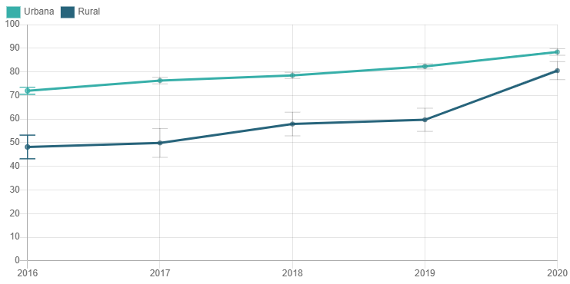
Meaningful Connectivity and the Digital Divide in Brazil
Percentage of Internet users in Brazil, divided by urban and rural areas
Reference: CGI.br/NIC.br, Centro Regional de Estudos para o Desenvolvimento da Sociedade da Informação (Cetic.br), Pesquisa sobre o Uso das Tecnologias de Informação e Comunicação nos domicílios brasileiros. Available at: https://data.cetic.br/explore/?pesquisa_id=1&unidade=Usuários.

Slide 5
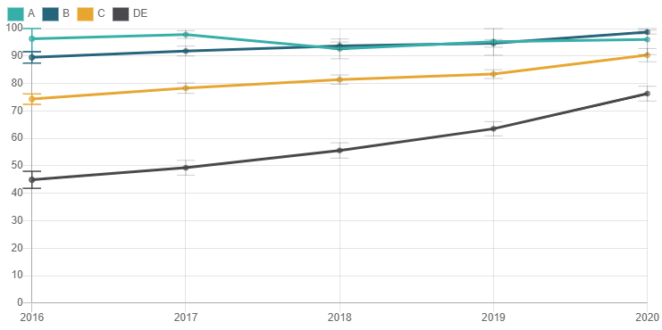
Meaningful Connectivity and the Digital Divide in Brazil
Subtitle:
A: monthly household income higher than R$22,000.00
B: monthly household income between R$ 7,100.00 and R$22,000.00
C: monthly household income between R$ 2,900.00 and R$ 7,100.00
D/E: monthly household income up to R$2.9 thousand
Reference: CGI.br/NIC.br, Centro Regional de Estudos para o Desenvolvimento da Sociedade da Informação (Cetic.br), Pesquisa sobre o Uso das Tecnologias de Informação e Comunicação nos domicílios brasileiros. Available at: https://data.cetic.br/explore/?pesquisa_id=1&unidade=Usuários.

Slide 6
Meaningful Connectivity and the Digital Divide in Brazil
Alliance For Affordable Internet (A4AI): meaningful connectivity is comprehended as processes that will help the development of a full Internet connectivity and will assist the establishment of public policies related to the digital development

Slide 7
Meaningful Connectivity and the Digital Divide in Brazil
Regular Internet Use
Access to an appropriate device
Availability of sufficient data for use and access to a fast connection

Slide 8
Meaningful Connectivity and the Digital Divide in Brazil
There are several theoretical and conceptual limitations related to the concepts of digital inequalities and of the binomial digital inclusion/exclusion
Cristina Mori (2011) proposes a schematization, in which the different understandings about this social phenomenon can be gathered in three analytical axes:
  a) digital inclusion as access;
  b) digital inclusion as digital literacy;
  c) digital inclusion as appropriation of technologies

Slide 9
Meaningful Connectivity and the Digital Divide in Brazil
For this research:
  The notion of digital inclusion as the appropriation of Information and Communication Technologies (ICTs) is adopted
Digital inclusion:
  More than providing digital literacy for the people.
  Existence of processes that allow users to understand the meaning of technical and digital media
  Digital inclusion as means to subvert the logic of internet users as consumers

Slide 10
Internet Community Networks (CNs) and Digital Inclusion
Internet Community Networks (CNs):
  Collectively organized and managed non-profit networks
  Principles: democratic participation, equity, gender equality, diversity, and plurality
Since we are adopting the notion of digital inclusion as the appropriation of ICTs by individuals, CNs can be understood as a means to include those who are digitally excluded, once the users assume an active role in their relationship with technology , so as to subvert the logic by which the Internet is usually understood today, as a service offered by the private sector.

Slide 11
Thank you!
nathanprb18@gmail.com

